Slide 1
Lesson One
Create MVC Web Application
Dragos Rosca
Automatica si Calculatoare 2018

Slide 2
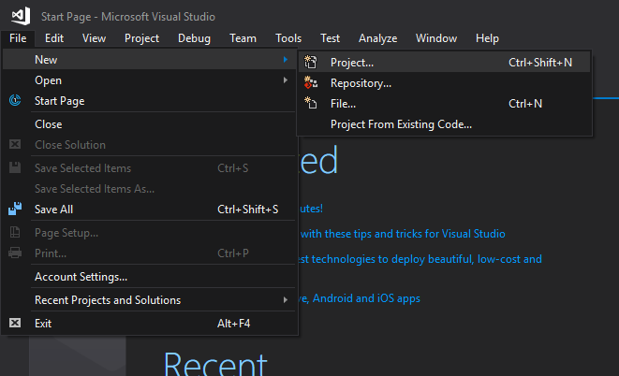
Create Project
Open File menu
Choose New
Click Project…
Or use the shortcut
Ctrl + Shift + N
This requires that your environment settings are set to C# developer

